Slide 1

CSE 2213: Discrete Mathematics Section - O Room No - 325
Prof. Dr. A.K.M. Muzahidul Islam
Computer Science & Engineering (CSE)
United International University (UIU)
Email: muzahid@cse.uiu.ac.bd
Fall 2024

Slide 2
SET
The fundamental discrete structure on which all other discrete structures are built.
Used to group objects together.
Often, but not always, the objects in a set have similar properties.
For Example, all the students who are currently enrolled at UIU make up a set.
Definition 1:
A set is an unordered collection of distinct objects, called elements or members of the set.
A set is said to contain its elements.
We write a ∈ A to denote that a is an element of the set A.
The notation a ∉ A denotes that a is not an element of the set A.
It is common for SETs to be denoted using uppercase letters.
Lowercase letters are usually used to denote Elements of Sets.

Slide 3
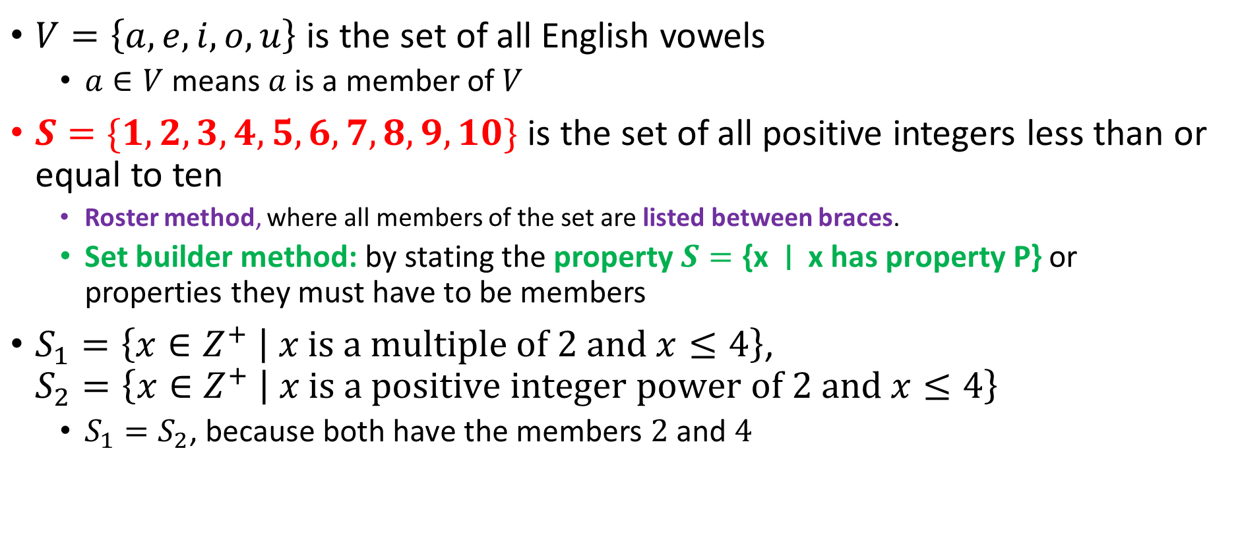
Sets

Slide 4
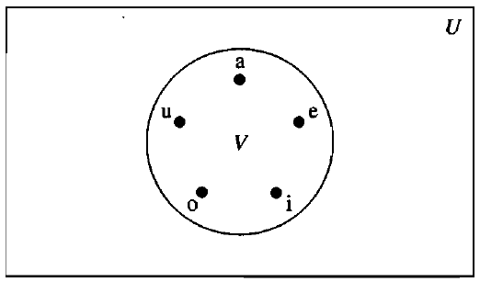
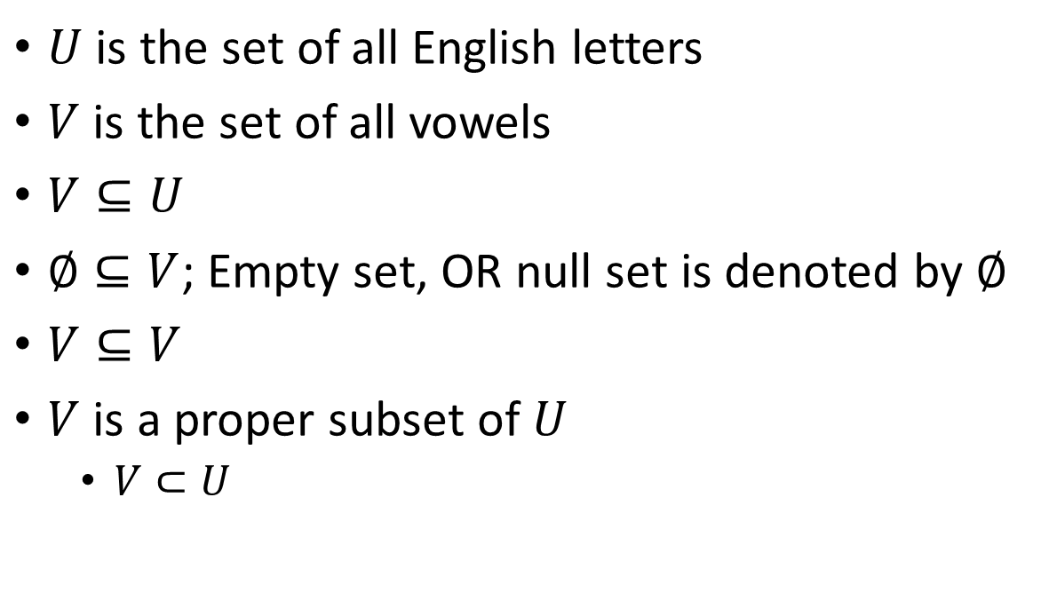
Subsets

Slide 5
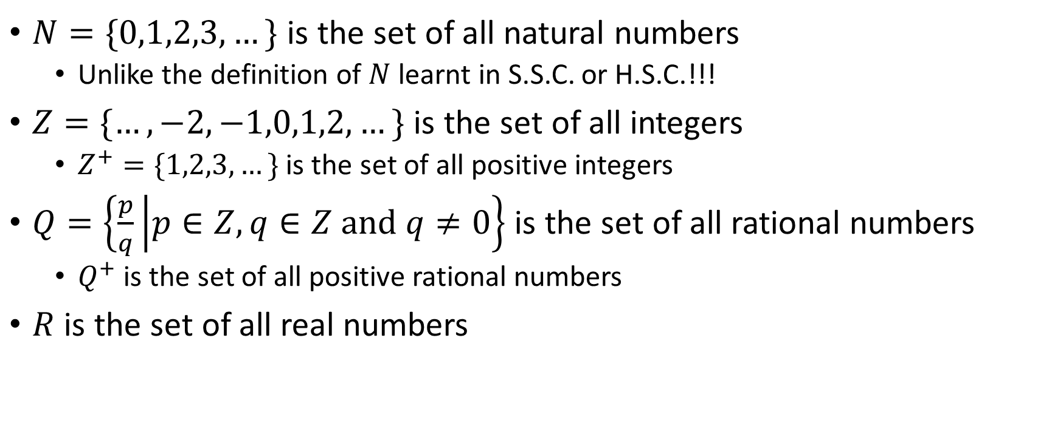
Some important sets

Slide 6
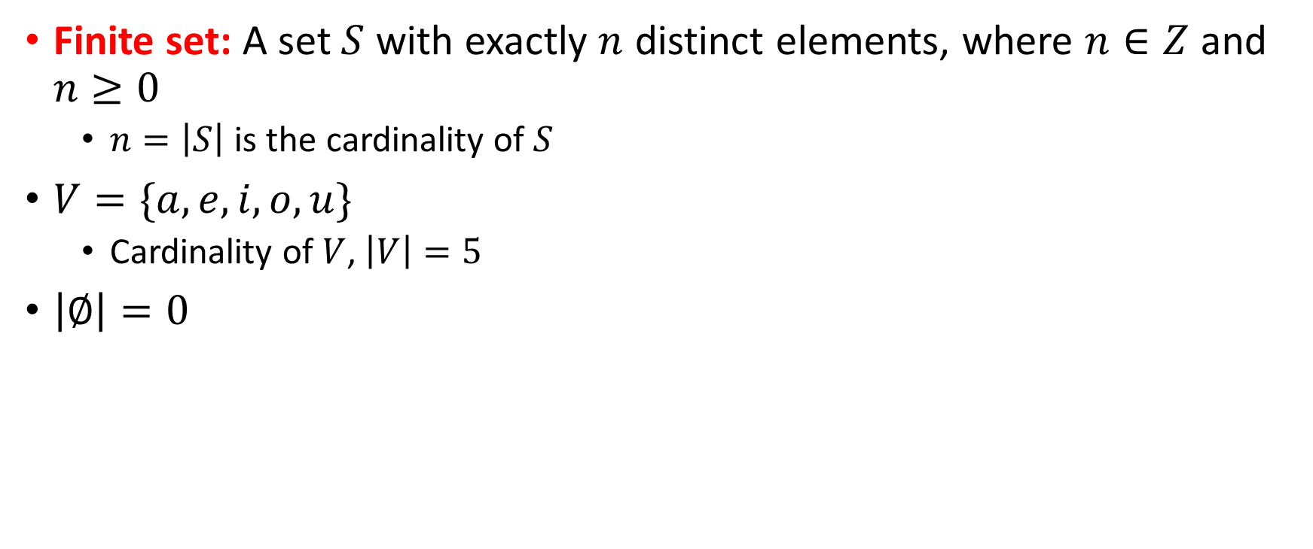
Cardinality of finite sets
Definition 2:
Two sets are equal if and only if they have the same elements. Therefore, if A and B are sets, then
A and B are equal if and only if ∀x(x ∈ A ↔ x ∈ B).
We write A = B if A and B are equal sets.

Slide 7
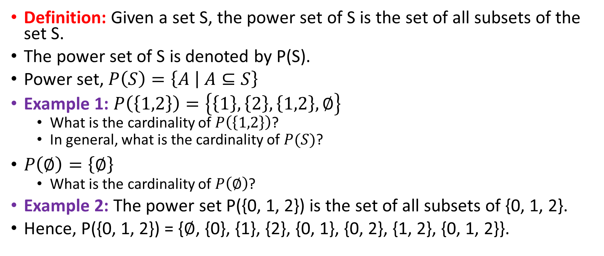
Power set

Slide 8
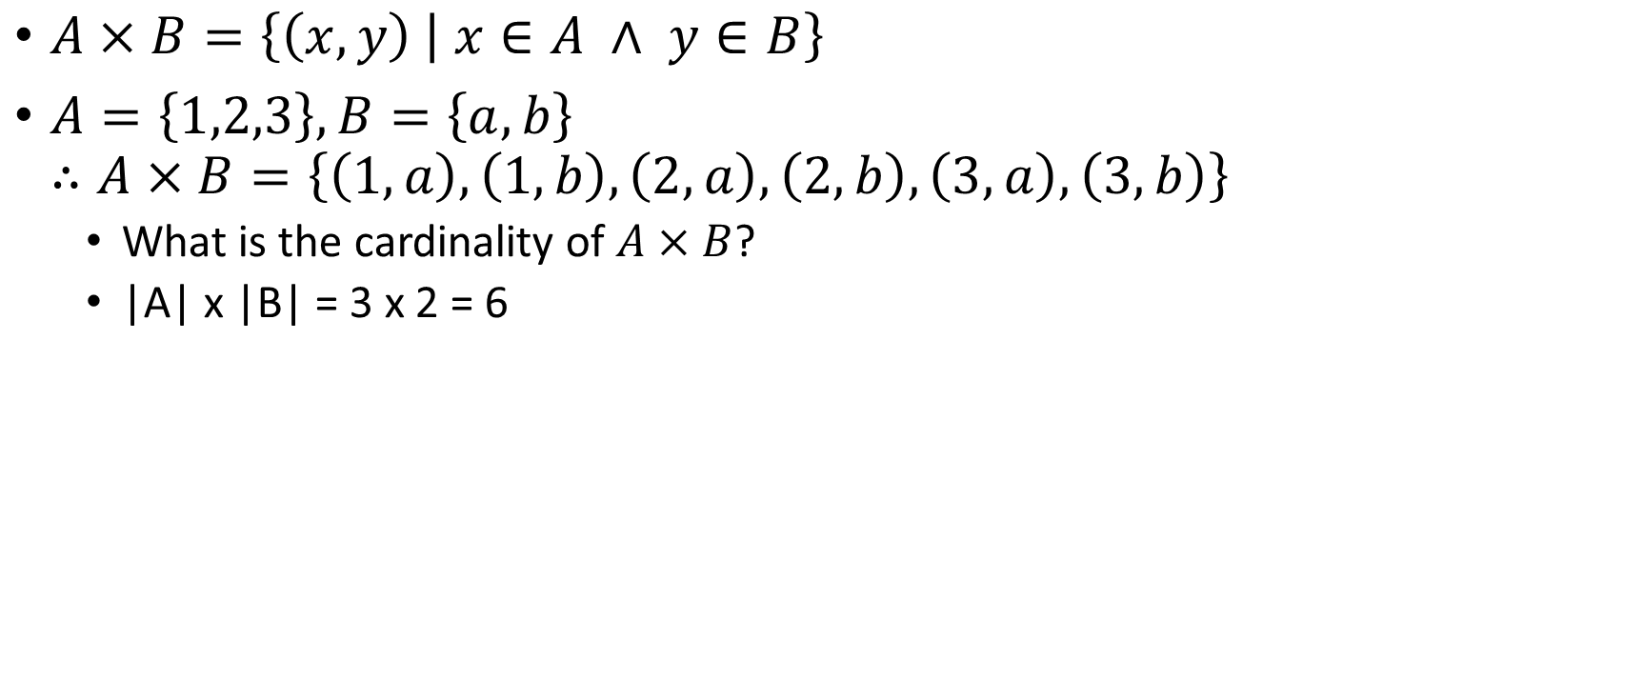
Cartesian product

Slide 9
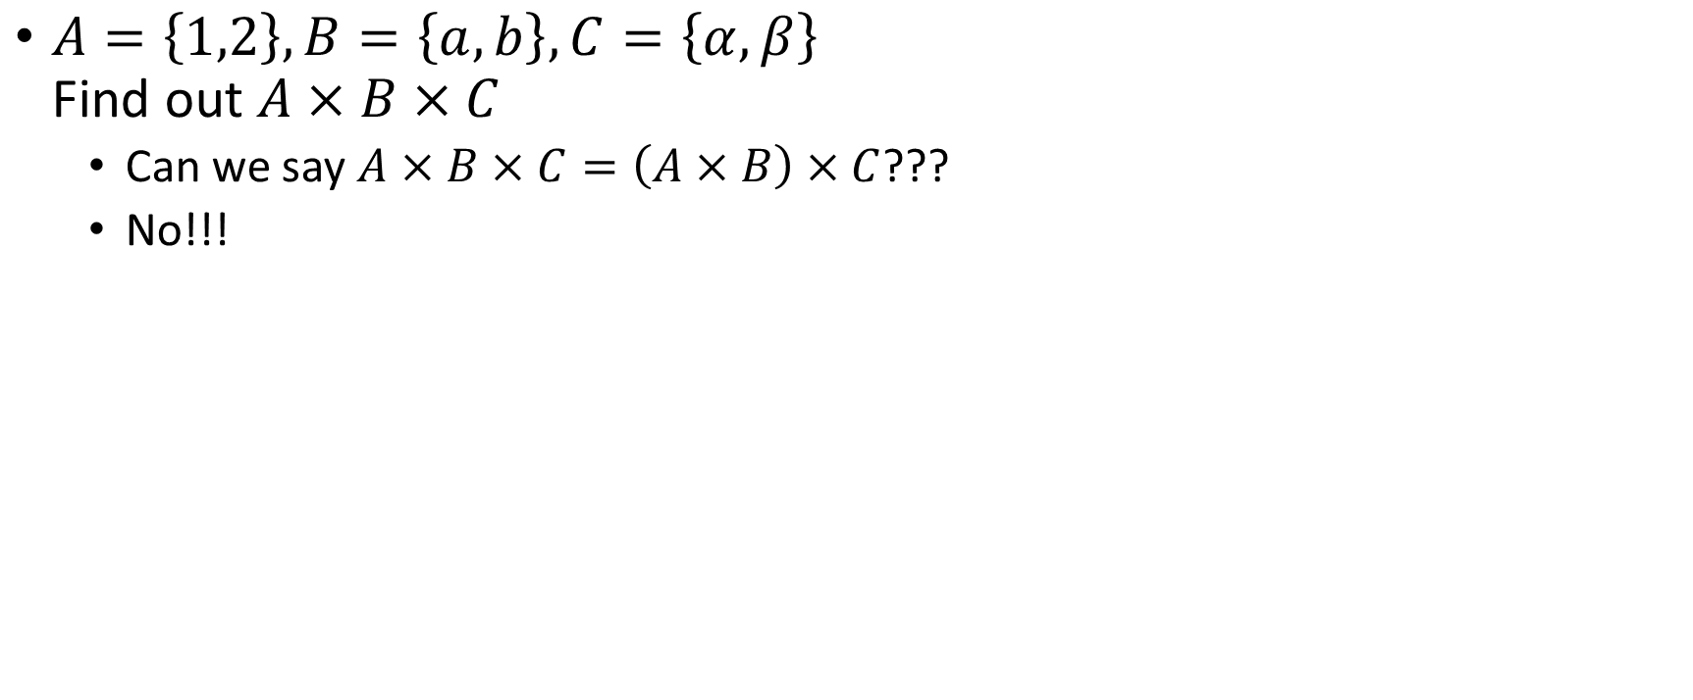
Cartesian product

Slide 10
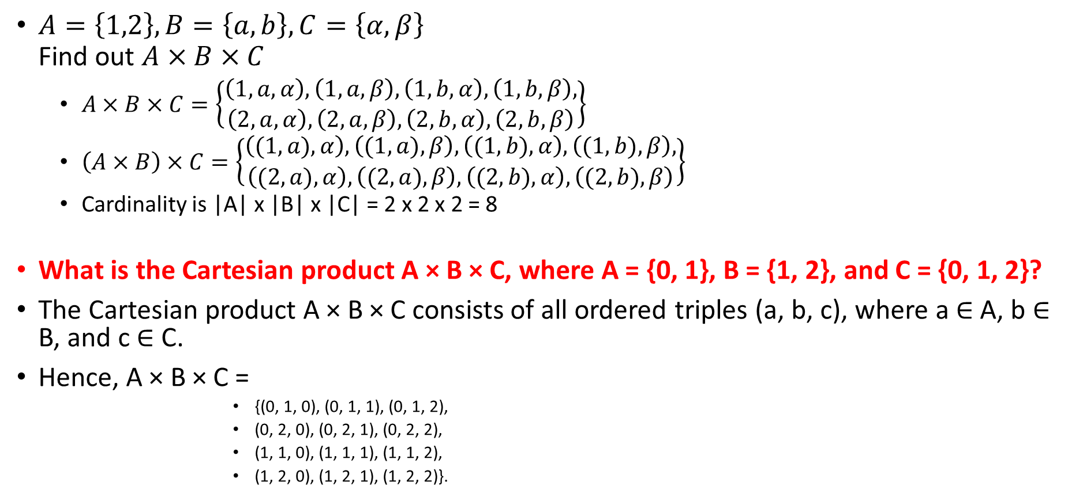
Cartesian product

Slide 11
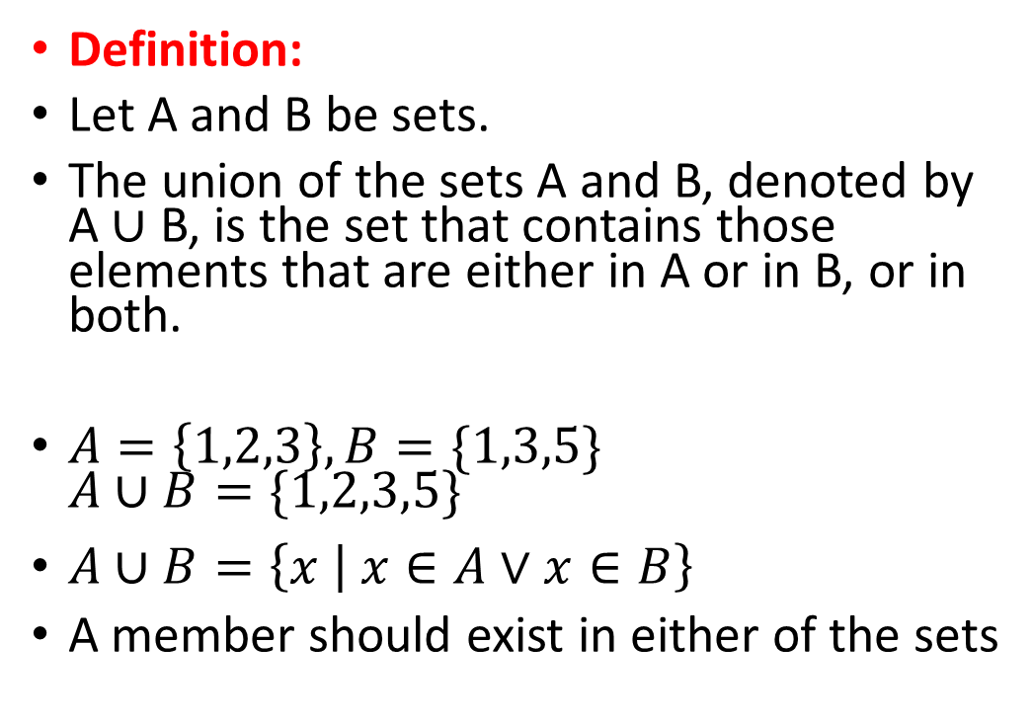
Set operations: Union
A
B

Slide 12
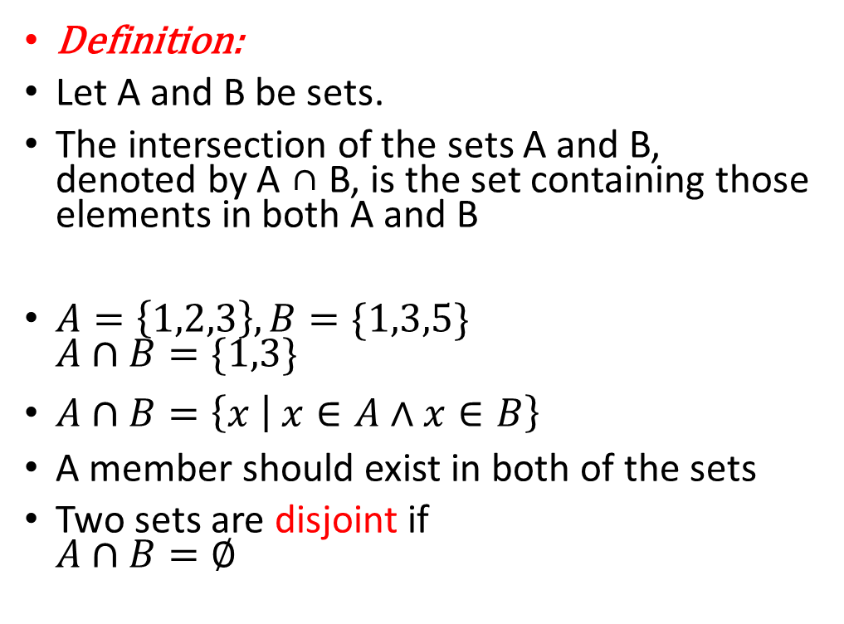
Set operations: Intersection
A
B

Slide 13
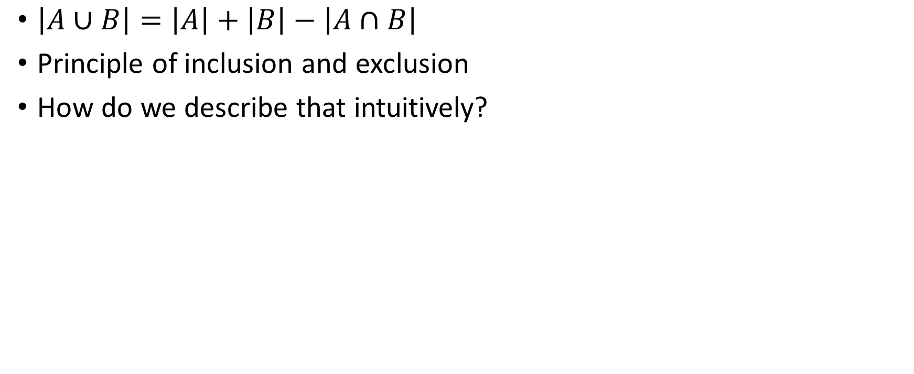
Cardinality of union set

Slide 14

Set operations: difference
A
B

Slide 15
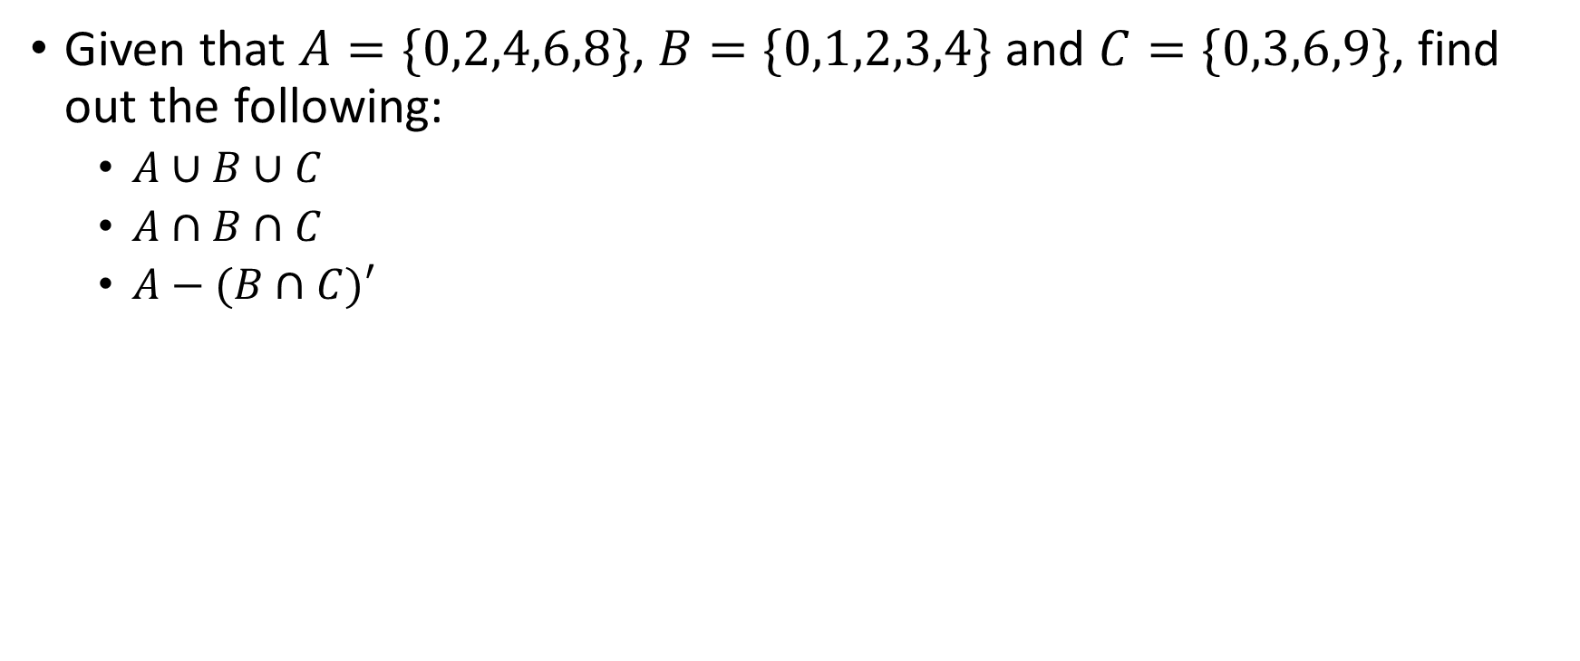
Problem

Slide 16
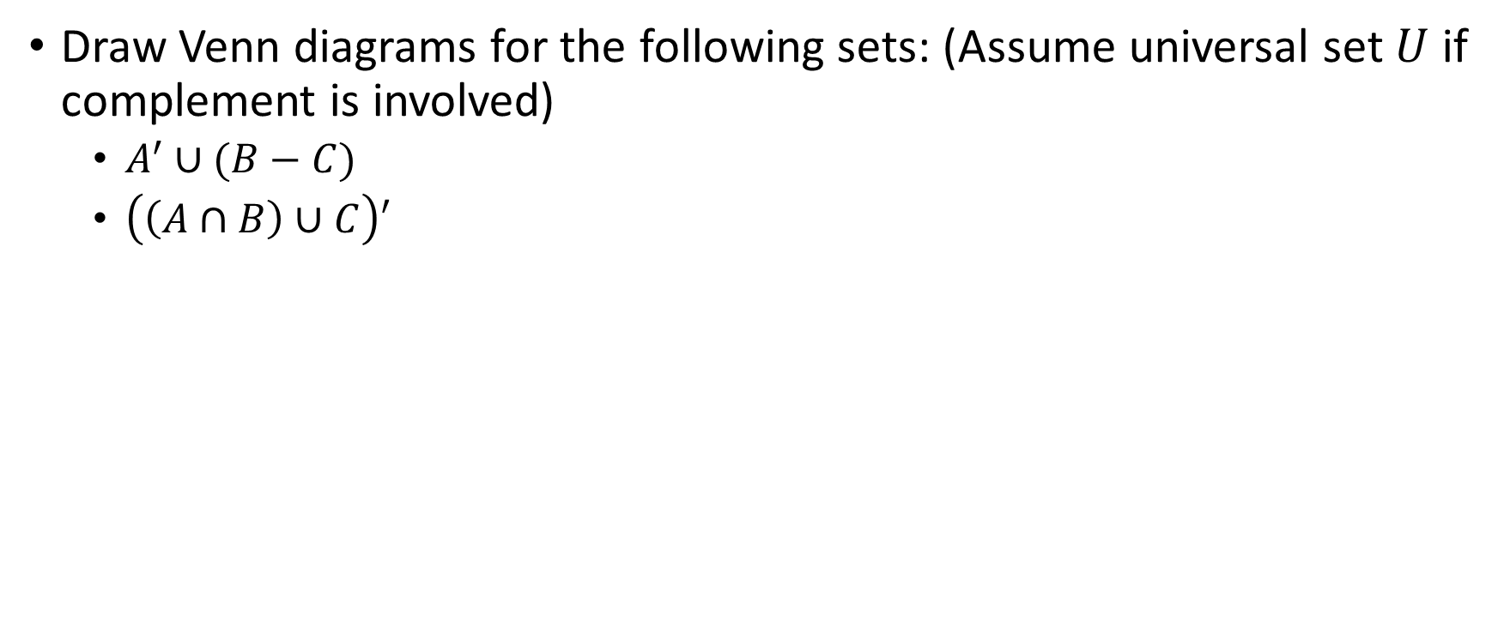
Problem
U
A
B
Sets can be represented graphically using Venn diagrams, named after the English mathematician John Venn, who introduced their use in 1881.
In Venn diagrams the universal set U, which contains all the objects under consideration, is represented by a rectangle
C

Slide 17
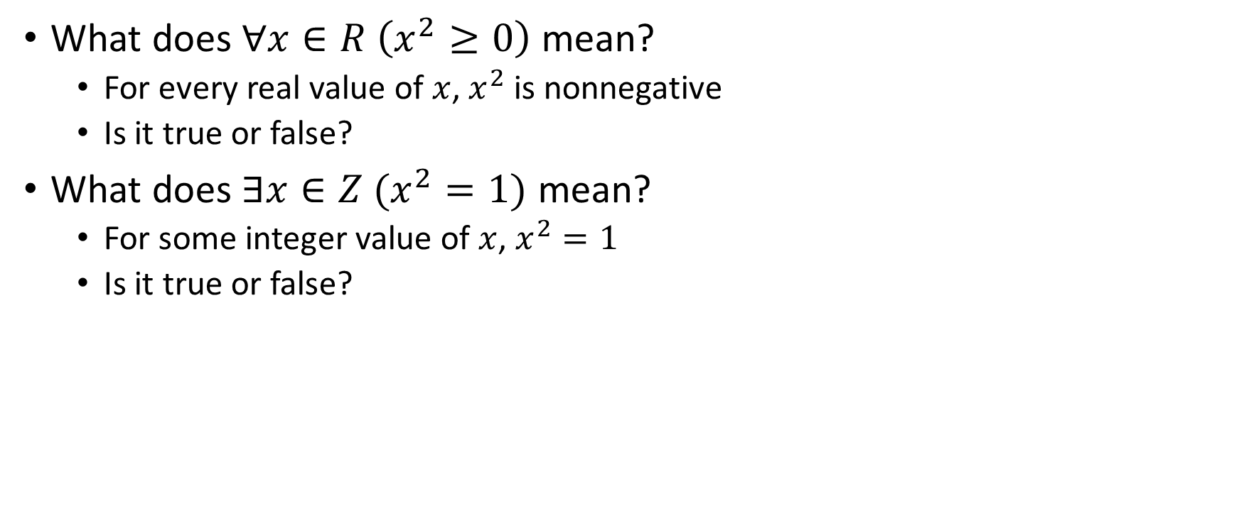
Restricting quantifiers with sets

Slide 18
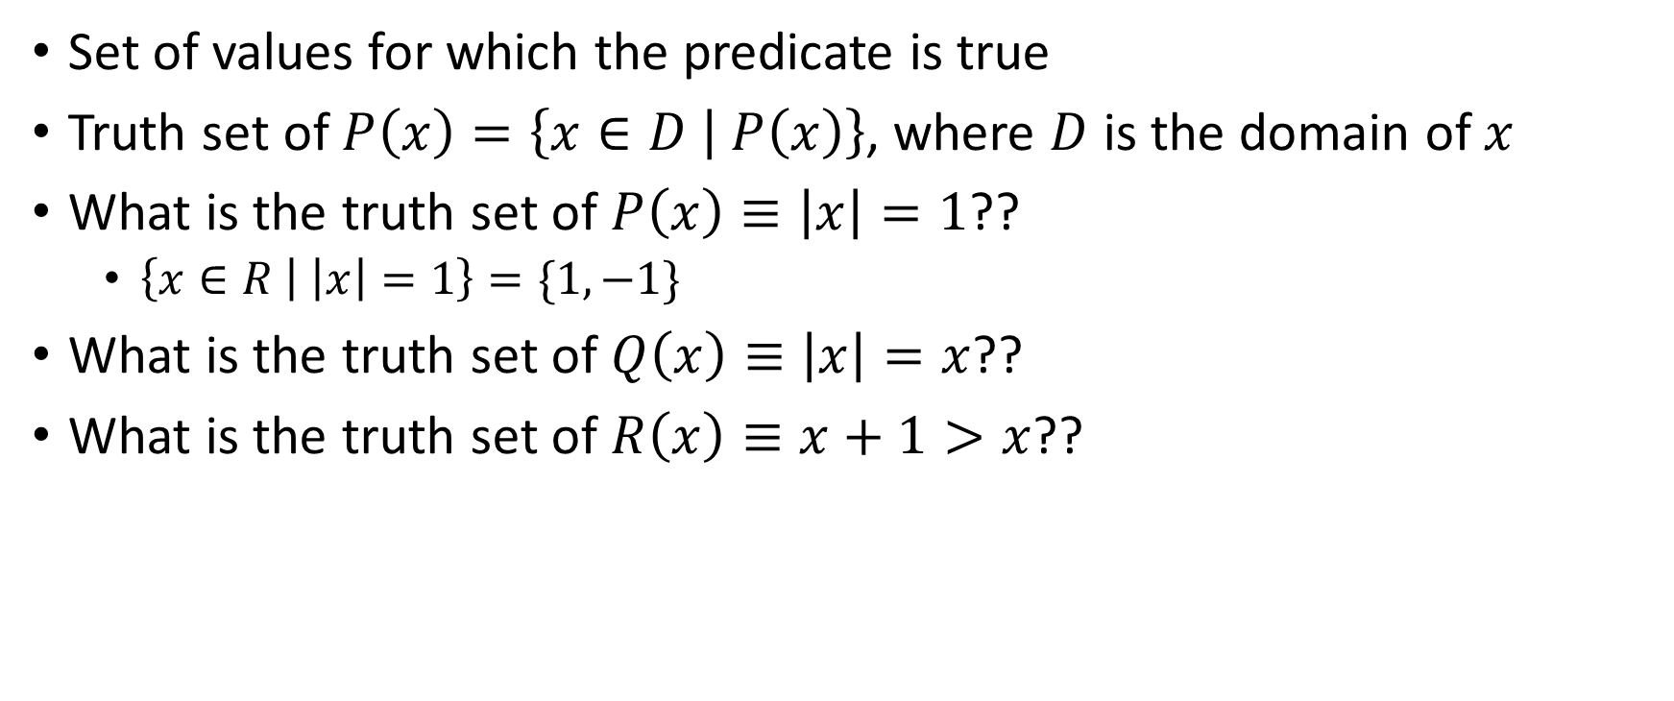
Truth sets of predicates

Slide 19
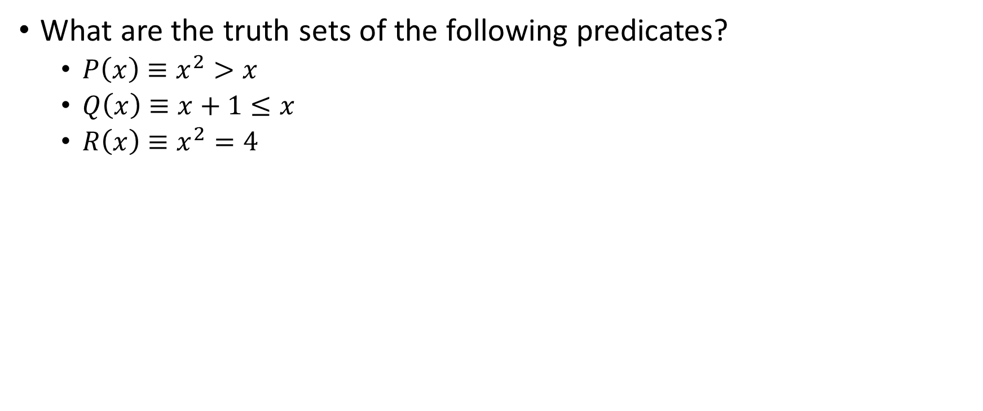
exercise

Slide 20


